Slide 1
Start a Python Project

Slide 2
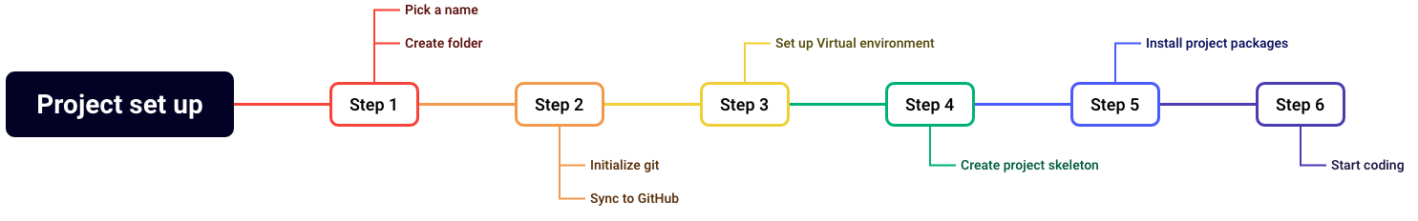
Basic structure to start a project
To keep things tidy
Notes:
It is slightly more relevant to follow a similar structure in all your python scripting. That has mainly to do with step 3: set up a virtual environment.
As mentioned, Python has a lot of functionality within in the standard library. But its strength lies in the rich ecosystem of Packages that can be added and used.
Packages are a collection of code that exists outside of the standard library. And for managing the packages, it is important to set-up a virtual environment.

Slide 3
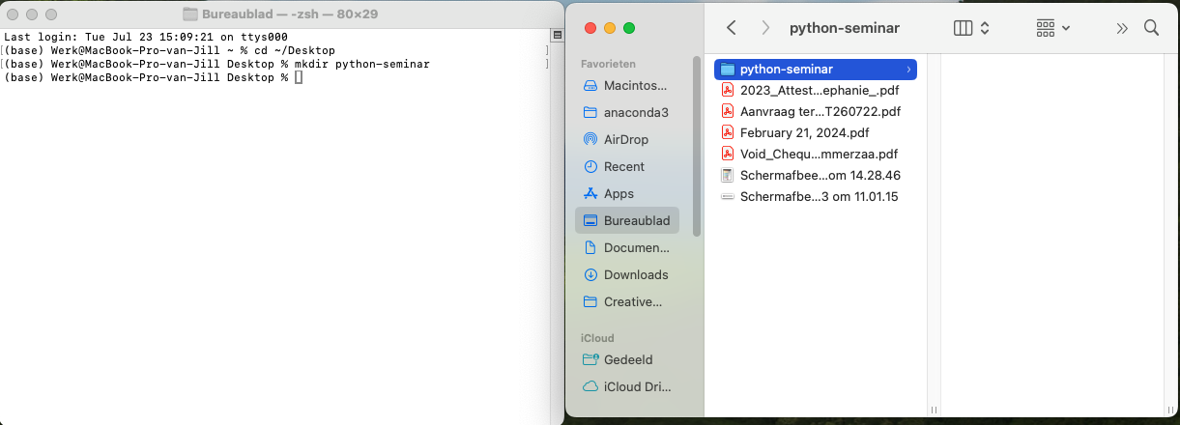
Step 1: Pick a name and create a folder
One project = one paper = one folder = one git repository

Slide 4
Step 2: Initialize Git

Slide 5
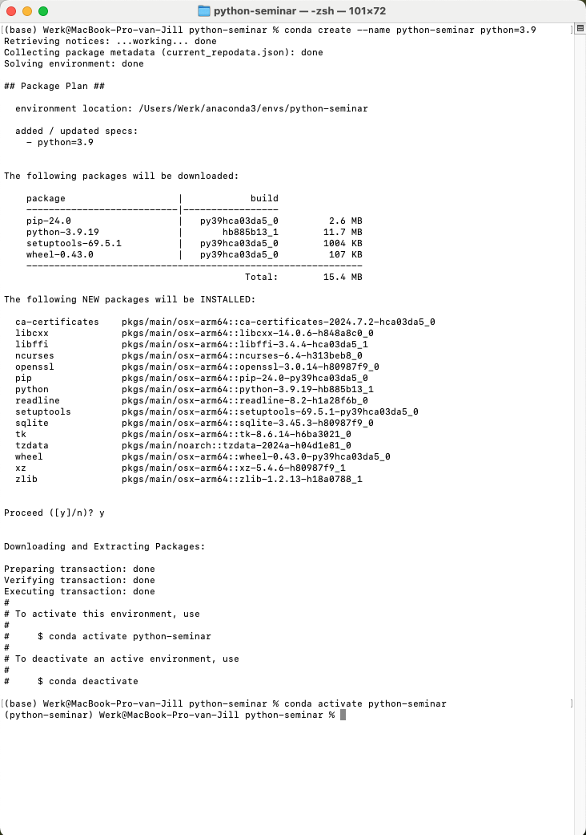
Step 3: Virtual environment
Part 1: Conda
conda create –name {project name} python=3.9
conda activate {project name}
{ } substitute to your own project name.
In this case python-seminar
Notes:
If you have followed the instructions on the shared repo, you have installed Miniconda, cloned the repository, navigated to the folder on your local system and installed the virtual environment.
Now, if you got stuck after step 1, no worries, I’ll walk you through the steps of setting up a brand new, shiny, and empty virtual environment.
And there you have it, a new environment. Once it’s activated, notice that the (base) at the start of the code line, has changed to the name of you package.

Slide 6
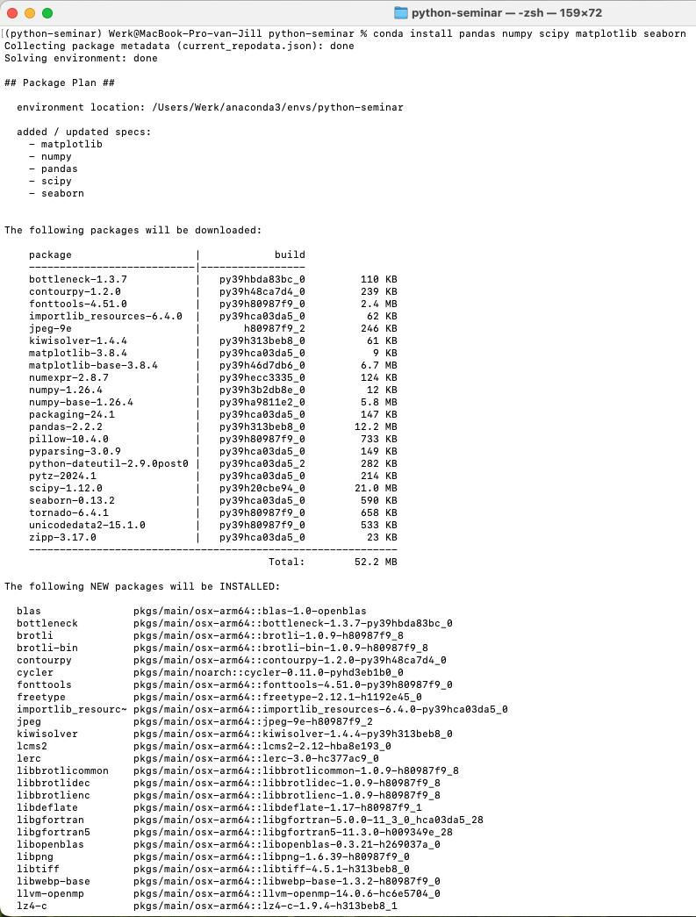
Step 3: Virtual environment
Part 2: installing packages
conda install pandas numpy scipy matplotlib seaborn
Notes:
Installing packages is then easy. Just type conda install with the names of the packages you’d want to use.
There you have it. With a few simple commands in the terminal or the command line, you have set-up your virtual environment and installed the most used packages for biomechanics.

Slide 7
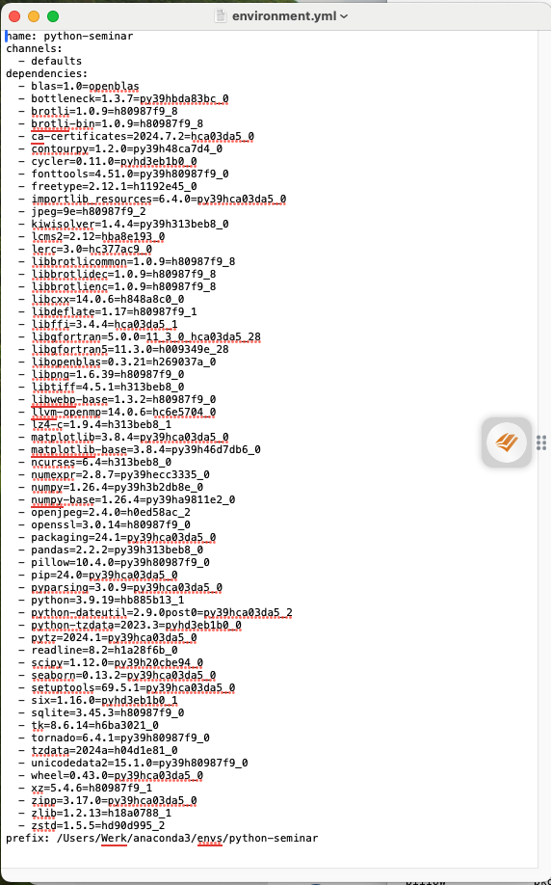
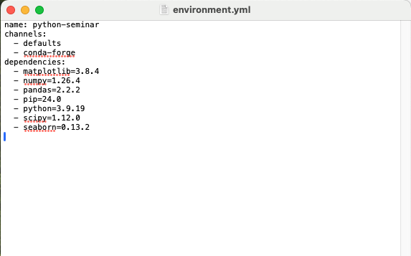
Step 3: Virtual environment
Part 3: exporting the environment
conda env export > environment.yml
Notes:
Now that we have our virtual environment, and the best thing to do is export a list so that you easily recreate your environment.
Command is conda env export > environment.yml
That creates the environment file within your folder.
But if you open this, it looks a lot different from the document that is on most repositories. This is because this environment file is specific to your device. If you want to create an environment file to share for another computer, you’d need to manually edit it.
The installation of the packages shown in the right figure will create the same environment as shown in the left.
So now that we have the first three steps competed, let’s go to step 4. Create a project skeleton.

Slide 8
Step 4: Project skeleton
|-- data: raw data for the project
|-- docs: all documentation
|-- results: All results
|-- scripts: All scripts
|-- src: Reusable Python modules
|-- tests: Tests for your codes
-- .gitignore: List of files git should ignore
-- environment.yml: virtual environment
-- README.md: description of the project
mkdir {data,docs,results,scripts,src,tests}
Notes:
This project skeleton is from goodreseach.dev But it is a good place to start. It combines ideas from shablona and good enough practices in scientific computing. So must be worth something…
This piece of code will create the following folders within the current working directory: data, docs, results, scripts, src, tests.

Slide 9
Step 5: Install (project) packages
Conda versus Pip
Conda versus pip:
Conda is both a package manager and a virtual environment and can install big, complicated, non-python packages but not all packages can be installed through conda
Pip is just a package manager and can install only install Python packages but can install them all. Including local packages
conda install {numpy} {pandas} {} {} {}
OR
pip install {numpy} {pandas} {} {} {}

Slide 10
Step 6: Start coding

Slide 11
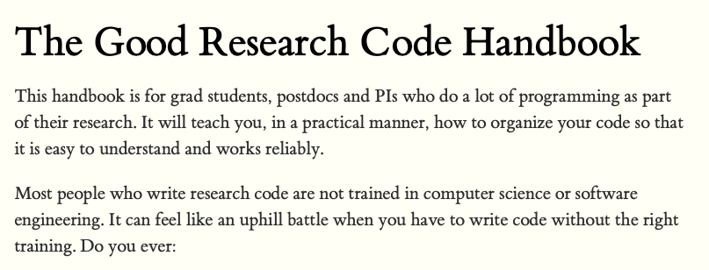
Take home message
Work for your future self
Using Virtual environments allows you to recreate the environment in the far future.
Good source is the the good research code handbook

